Slide 1

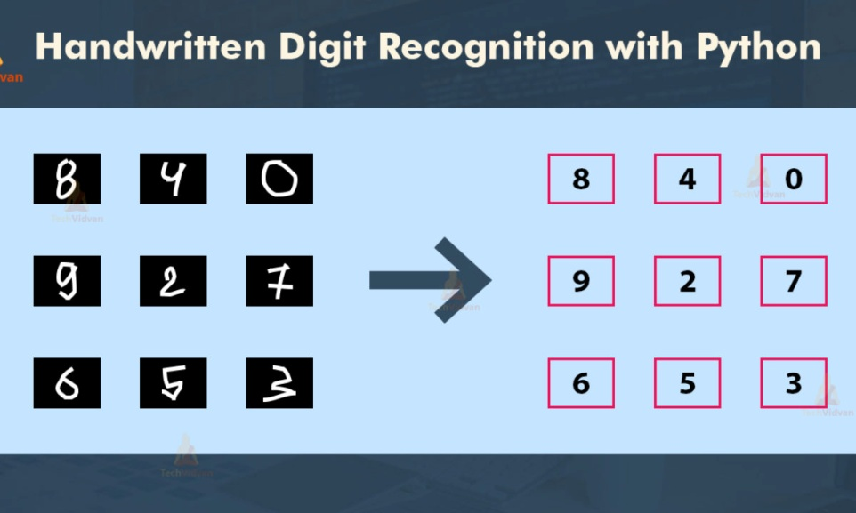
MINI PROJECT
DOMAIN:
MACHINE LEARNING
TITLE:
HAND WRITTEN DIGIT RECOGNITION
By
Poojasree SJ
Vignesh C
Ramani N

Slide 2
INTRODUCTION:
Handwriting recognition is the ability of a computer or device to take as input handwriting from source such as printed physical documents, pictures and other devices.
It also can use handwriting as a direct input to a touch screen and then interpret as text
There many device now can take handwriting as an input such as smartphones , tablets and PDA to a touch screen through a stylus or finger.
This is useful as it allows the user to quickly write down number and text to the devices.

Slide 3
.
There are many applications for handwriting recognition are available this day.
There are many technique that have been developed to recognize the handwriting.
In this project, we are going to compare two algorithms Support Vector Machine (SVC) and Random Forest Classifier to recognize Handwritten Digits .

Slide 4
LITERATURE SURVEY
S.NO | TITLE | AUTHOR(S) | SOURCE (DETAILS OF PUBLICATION) | FINDINGS
1 | Using Random Forests for Handwritten Digit Recognition | S. Bernard S. Adam L. Heutte | IEEE ( Ninth International Conference on Document Analysis and Recognition (ICDAR 2007)) | This aims at studying those methods in a strictly pragmatic approach, in order to provide rules on parameter settings for practitioners. For that purpose we have experimented the forest-RI algorithm, considered as the random forest reference method, on the MNIST handwritten digits database.
2 | On-line handwritten digit recognition based on trajectory and velocity modeling | MonjiKheralla LobnaHaddad Adel M.Alimi AmarMitiche | Elsevier-- The General Direction of Scientific Research and Technological Renovation (DGRSRT), Tunisia, under the ARUB program , 2008 | A system and associated methodology recognizes an Arabic like alphanumeric character using fuzzy modeling. The method receives a handwritten Arabic like alphanumeric character, stores fuzzy models of a plurality of Arabic like alphanumeric characters…

Slide 5
3 | Handwritten Digit Recognition Using Chemical Reaction Optimization | Pritam Khan Boni Bappy Shahriar Abir Md Rafiqul Islam H.M. Mehedi Hasan | IEEE 2018 9th International Conference on Computing, Communication and Networking Technologies (ICCCNT) | This paper propose a new methodology to recognize handwritten Bengali numerals using a recently established metaheuristic algorithm known as Chemical Reaction Optimization (CRO) in order to increase the recognition accuracy. The proposed method produces a higher accuracy rate, 98.96% which is higher than the outcome of any other proposed method.
4 | Effective handwritten digit recognition based on multi-feature extraction and deep analysis | Caiyun Ma Hong Zhang | IEEE 2015 12th International Conference on Fuzzy Systems and Knowledge Discovery (FSKD) | It propose specific feature definitions, including structure features, distribution features and projection features It results on benchmark database of MNIST handwritten digit images show that the performance of our algorithm is remarkable and demonstrate its superiority over several existing algorithms.

Slide 6
Problem definition:
The goal of this project is to compare Support Vector Machine and Random Forest Classifier and find which algorithm is best for Handwritten digit recognition.
In this review, we created a model that will be able to recognize and determine the handwritten digits from its image by using the SVM.
Though the goal its to create a model which can recognize the digits it can be extended to letters and an individuals handwriting.
The major goal of the project is understanding SVM, Random forest and applying it to the handwritten recognition system.

Slide 7
Project objectives:
The handwritten digits are not always of the same
size , thickness, or orientation and position relative to the margins.
It is a tough task for the machine because handwritten characters are not perfect. The same Characters differ in sizes, shapes and styles from person to person and even from time to time with the same person.
Handwritten Digit recognition is the solution to this problem that uses the image of a digit and recognizes the digit present in the image.

Slide 8
SVM (Support Vector Machines)
In Machine Learning, Support Vector Machines (SVM) are supervised Learning models with associated learning algorithms that analyze data and recognize patterns, used for classification and regression analysis.
SVM is based on the concepts of decision planes that define decision boundaries.
A decision plane is one that separates between a set of objects having different class memberships.
SVM became famous when, using images as input, it gave accuracy comparable to neural-network with in a handwriting recognition task.
Currently, SVM is widely used in object detection & recognition, content-based image retrieval, text recognition, biometrics, speech recognition etc..

Slide 9
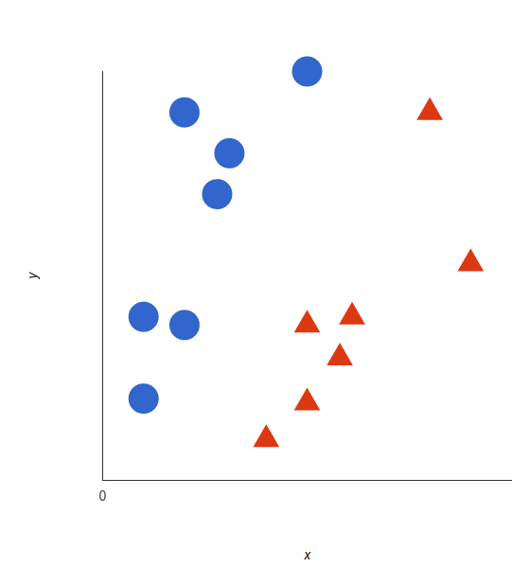
WORKING OF SVM FOR LINEAR DATA
The basics of Support Vector Machines and how it works are best understood with a simple example.
Let’s imagine we have two tags: red and blue, and our data has two features : x and y. We want a classifier that, given a pair of (x,y) coordinates, outputs if it’s either red or blue.

Slide 10
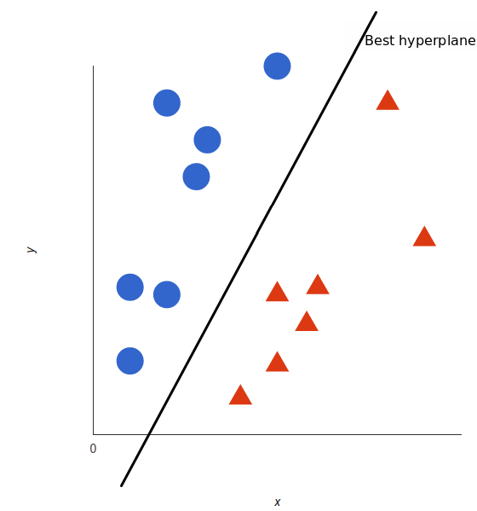
.
A support vector machine takes these data points and outputs the hyperplane (which in two dimensions it’s simply a line) that best separates the tags. This line is the decision boundary: anything that falls to one side of it we will classify as blue, and anything that falls to the other as red.

Slide 11
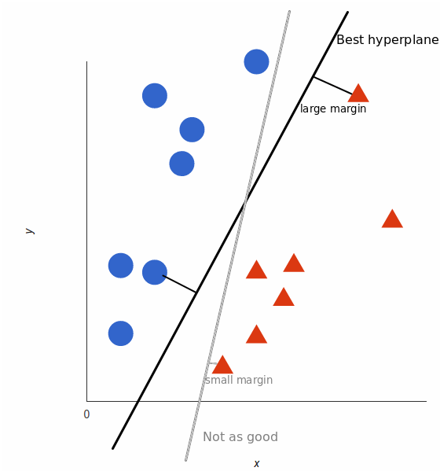
.
But, what exactly is the best hyperplane? For SVM, it’s the one that maximizes the margins from both tags.
In other words: the hyperplane (it's a line in this case) whose distance to the nearest element of each tag is the largest.

Slide 12
Maximum Margin
The maximum margin linear classifier is the linear classifier with the maximum margin.
This is the simplest kind of SVM (Called an LSVM)
Linear SVM
Support Vectors are those datapoints that the margin pushes up against

Slide 13
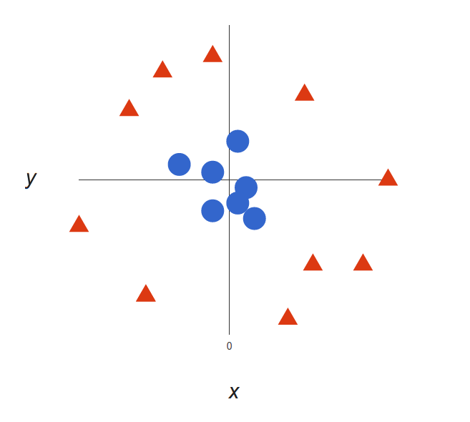
FOR NONLINEAR DATA
Take a look at this Example
It’s pretty clear that there’s not a linear decision boundary (a single straight line that separates both tags).
However, the vectors are very clearly segregated and it looks as though it should be easy to separate them.
In this case, it is calculated in a certain way that is convenient for us : z = x² + y² that’s the equation of a circle.

Slide 14
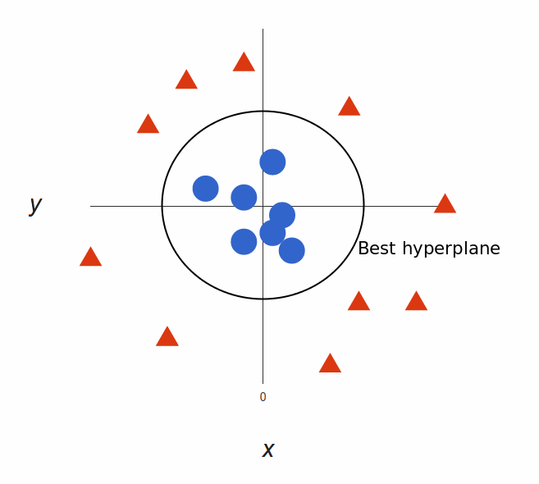
.
Our decision boundary is a circumference of radius 1, which separates both tags using SVM.

Slide 15
PLATFORM : Anaconda Navigator LANGUAGE : Python IDE : Jupyter Notebook

Slide 16
LIBRARIES :
Pyscreenshot
Pandas
Scikit-learn
Matplotlib
joblib
Numpy
Opencv-python
MODULES :
Time
cv2
csv
Glob

Slide 17
Divided into four steps :
Screen capture
Generate dataset and load it
Fit the model using SVC and calculate accurancy
Prediction of image drawn in paint

Slide 18
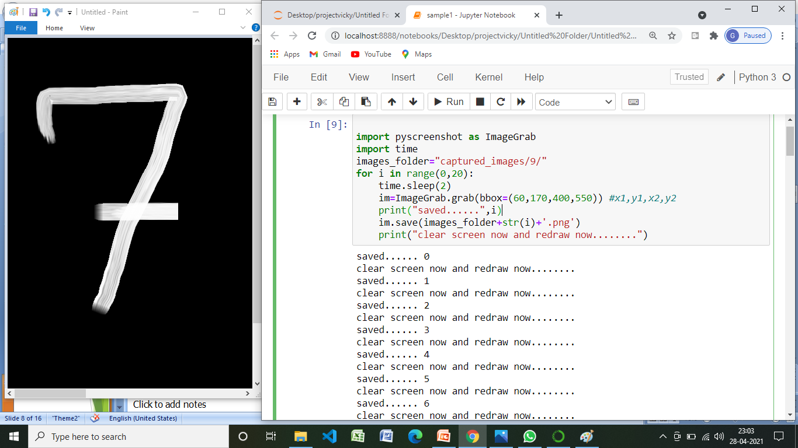
.
Screen capture
Using pyscreenshot we created own dataset
im=ImageGrab.grab(bbox=(60,170,400,550)) #x1,y1,x2,y2

Slide 19
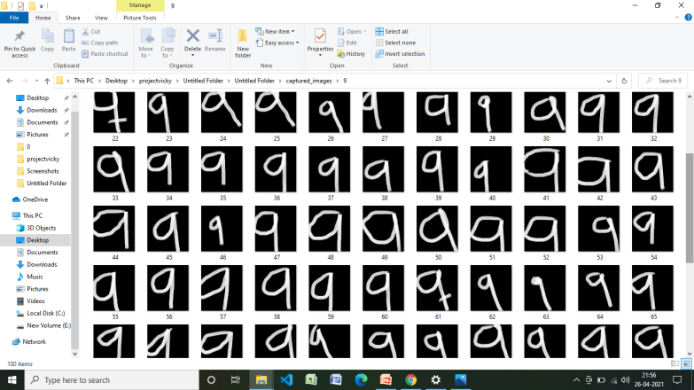
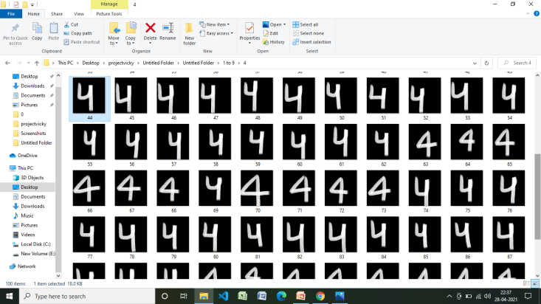
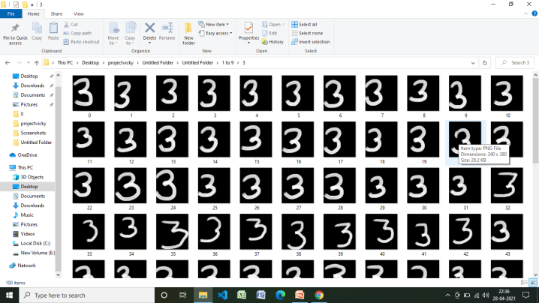
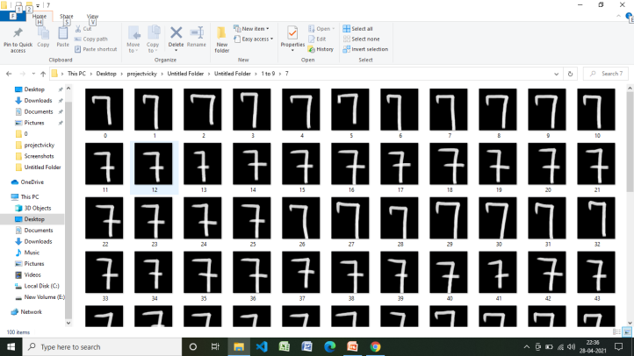
.
In our dataset ,we created 10 folders [0-9]
Each one has an 100 images and totally there are 1,000 images
For training we used 80% of dataset and for testing we used 20% of dataset

Slide 20
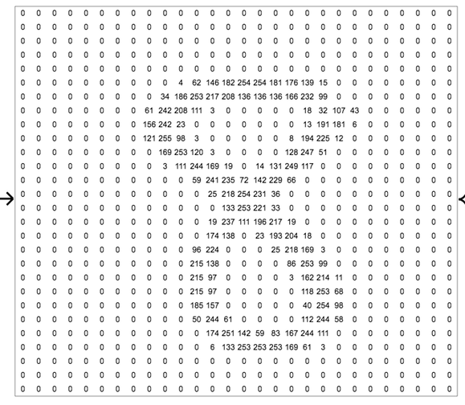
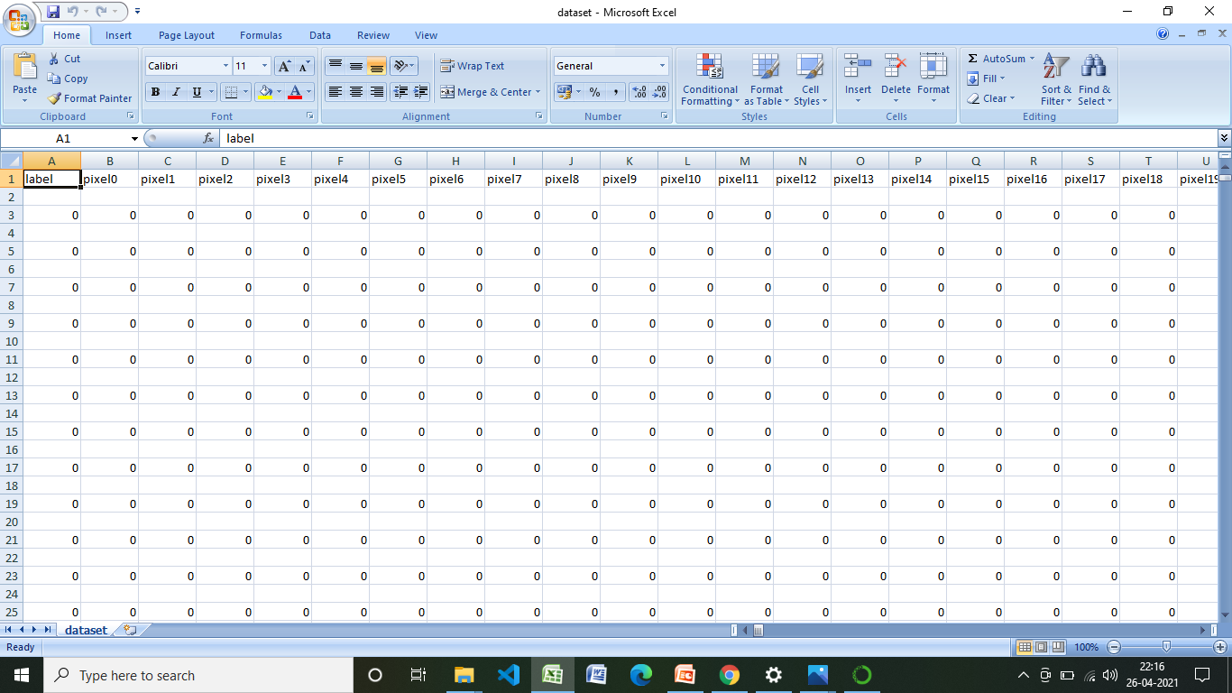
Genrate dataset
Appended pixel value from 0 to 783
Extracted image folder
Read all the images using cv2 module
Convert rgb to grayscale image
Using gaussian blur method blur images
Resize the image into 28 *28 pixel
Add pixel one by one into data array
Append the data ie..0 & 1 value from pixel 0 to pixel 783

Slide 21
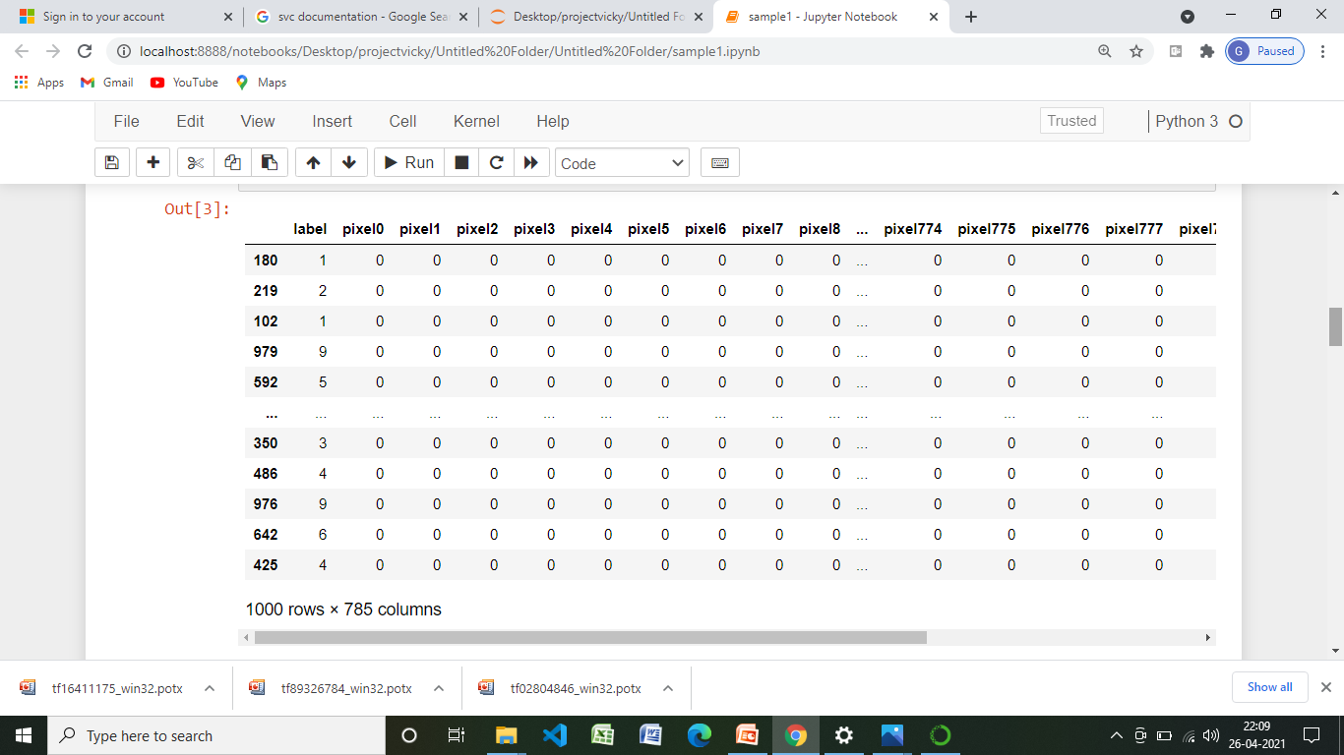
load the dataset
Loaded the data set using pandas library

Slide 22
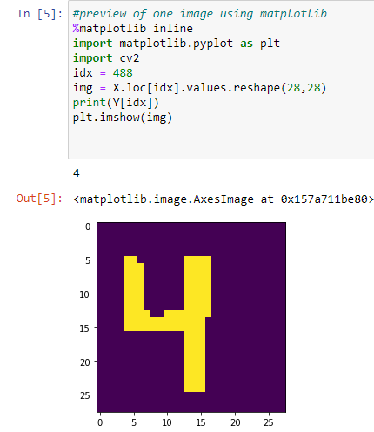
Separation of dependent and independent variable
Training dataset is stored in the form of x train & y train
Testing dataset is stored in the form of x Test & y Test
preview of image using matplotlib
Previewed
one image using index value from the loaded dataset

Slide 23
Train-Test split
80% of dataset for training the model
20 % of dataset for testing the model
Fit the model
Fit the model using svc & save the model using joblib

Slide 24
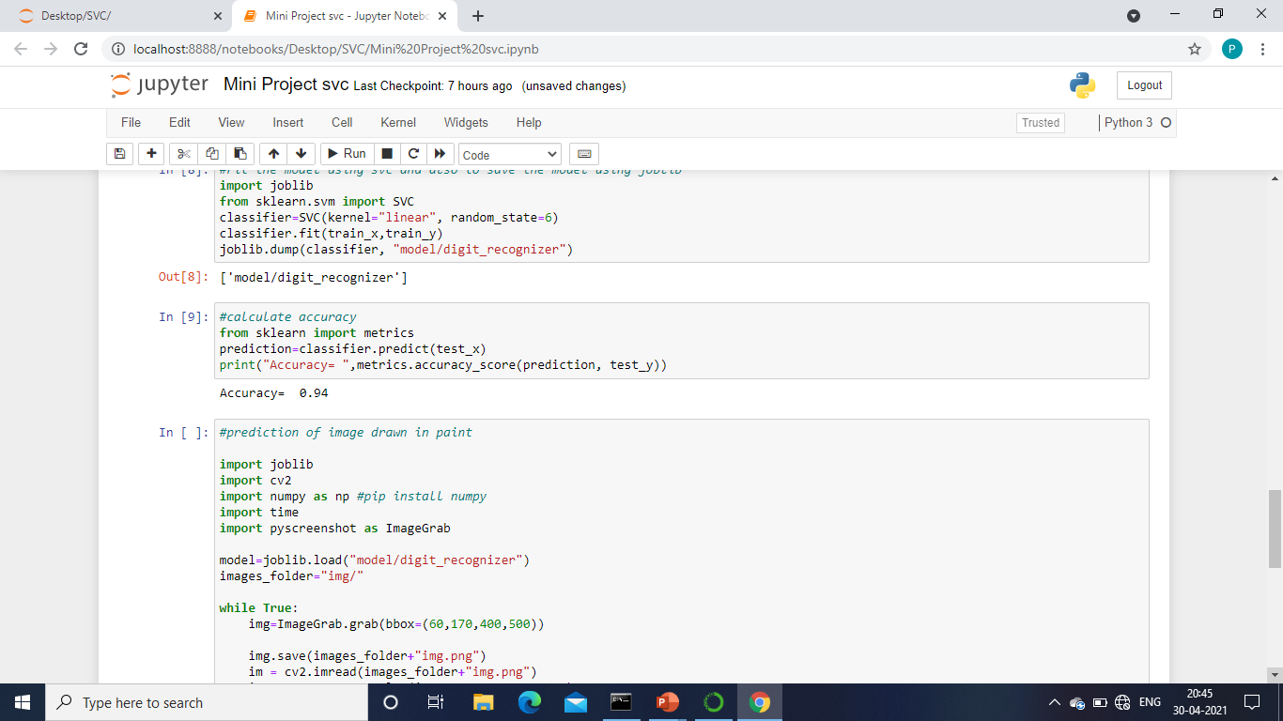
calculate accuracy
Testing dataset x test & y test is used to predict the image & calculate its accuracy

Slide 25
Prediction of image drawn in paint
predicting image using paint & pyscreenshot
And then using time module it will predict after completion of that time
Threshold the image
And then finally it will predict succesfully
Add pixel one by one into data array

Slide 26
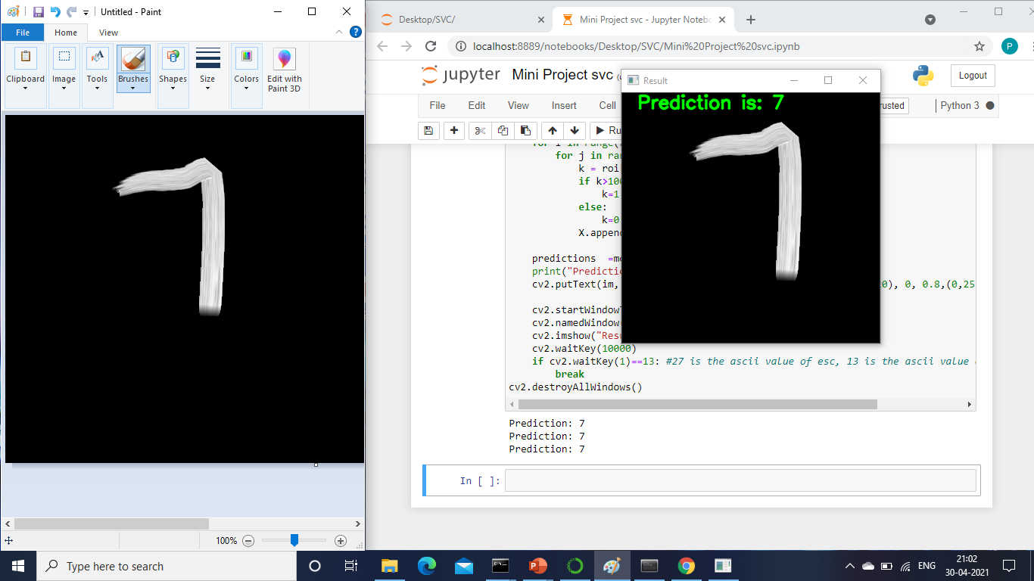
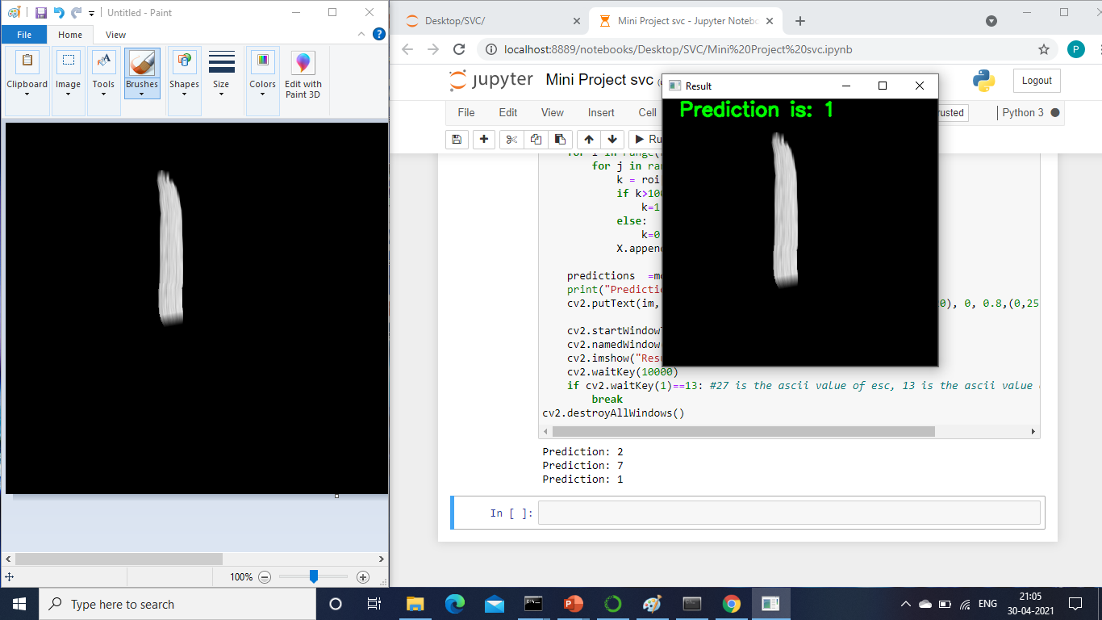
RESULTS AND OUTPUTS :

